Slide 1
Data collection

Slide 2













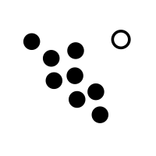


Results independently obtained by two scientists
Data preprocessing
Question Creation
check dataset quality
mismatch traits and conditions
remove invalid or trivial pairs
A third scientist adjudicates discrepancies
missing values imputation
Gene Expression Omnibus
Analysis
Results
remove invalid records
500+ records of
research
question
The Cancer Genome Atlas
batch effect correction
choose machine learning models
optimize model parameters
interprete
results
paired with
genes from data-driven methods
gene names standardization
repeat if necessary

